Slide 1

Web Application Development
Web Concepts and Tools
Success is not final Failure is not fatal It is the courage to continue that counts.
Winston Churchill

Slide 2
Web Concepts
How the web works

Slide 3





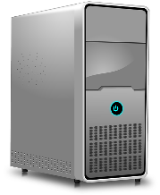

How the Web Works?
Domain name
IP address
Database
URL
DNS Server
HTTP request
Web
Browser
HTTP response
Processing Engines
Web Server
Resources
Notes:
Web server, database, processing engines, and resources are backend

Slide 4
How the Web Works – URL
Global identifier (address) of a resource on the web
Contains 5 components – Protocol, Host name, Port, Path, Query – combined and delimited as follows:
protocol://hostname:port/path?query
Protocol
tells your browser what type of service to use when you connect with the web browser to the hostname.
E.g., http, https, ftp, etc.
Host name (aka. domain name)
the address of the web server you are going to
E.g., http://smu.edu.sg
Notes:
If you specify another protocol like ftp,
then the browser will act as an ftp client that will enable you to connect to a ftp server to download files.

Slide 5
How the Web Works – URL ctd.
Port Number
a number appended to the hostname with a colon ( : ) between them; by default (if not specified): Port 80 is used
E.g., http://smu.edu.sg:3306
Path
path on the web server, pointing to the filename (resource) you are trying to reach
E.g., http://smu.edu.sg:3306/faculty
Query (optional)
provides information that the resource can use for some purpose
usually a string of name and value pairs separated with an ampersand ( & )
E.g., …/faculty?user=jack&password=123456
Notes:
If not explicitly specified, the browser will automatically use port 80 as that is the default port for the http protocol.

Slide 6
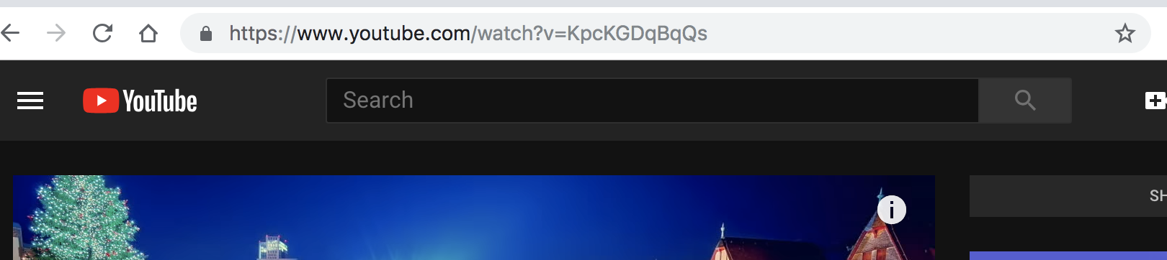
Example – URL
https://www.youtube.com/watch?v=KpcKGDqBqQs
Protocol: https
Hostname: www.youtube.com
Port number: 80 (since it’s not specified)
Path: watch
Query: v=KpcKGDqBqQs

Slide 7
How the Web Works – Web Browser
Also called ”Web Client”
Retrieves information on the web typically using HTTP
HTTPS – secure version of HTTP — is also getting popular
Render HTML, CSS, JavaScript, and other files (e.g., images)
Notes:
A software
Https is HTTP over SSL/TLS – communication is encrypted using TLS/SSL protocol

Slide 8
How the Web Works – DNS Server
Domain name service (DNS) server – an address book
Resolve website domain name (e.g., www.smu.edu.sg) to IP address (e.g., 45.64.64.148)
An IP address is the real address (unique location) of a website
Why like that?
Because IP addresses (e.g., 45.64.64.148) are not the nice, memorable strings
No DNS server contains the entire database of websites
If a DNS server doesn’t contain the domain name requested by the browser, it re-directs to another DNS server
Notes:
A distributed database which keeps track of website’s domain names and their corresponding IP addresses on the Internet

Slide 9
HTTP: Hypertext Transfer Protocol
Application layer request-response protocol that defines a language for clients and servers to speak to each other
Widely used
Simple
Stateless
Unencrypted
Analogy: this is like the language we use to communicate each other

Slide 10
HTTP Request
What the browser asks for
GET https://www.youtube.com/watch?v=KpcKGDqBqQs HTTP/1.1
Connection: keep-alive
User-Agent: Chrome/71.0.3578.98
Accept-Language: en-GB,en-US
Cookie: VISITOR_INFO1_LIVE=33Xi9Y1Y2mA; GPS=1; PREF=f1=50000000; YSC=U6uKYI-IJA0
Host: www.youtube.com
Request line (method, URI, protocol version)
Zero or more header
Empty line
Message body (optional)
Notes:
HTTP method GET or POST
URL
Referer -- Host
HTTP header

Slide 11
HTTP Response
What the server replies
Status line (version, status code)
Zero or more header
Empty line
Message body (optional)
HTTP/1.1 200 OK
Date: Mon, 10 Jan 2019 12:12:12 GMT
Server: Apache Expires: Sun, 19 Mar 2019 09:03:23 GMT Content-Encoding: gzip Content-Length: 19702 Content-Type: text/html; charset=UTF-8
<html>
…
</html>
Status code:
1xx: Informational
2xx: Success
3xx: Redirection
4xx: Client error
5xx: Server error
Notes:
Status codes:
Typical code: the 200 "status code" (sometimes called a response code) means the server has correctly located the page and is sending it to the browser.
A server can send a variety of other numeric codes too: if it can't find the page, it sends a 404 "Not Found" code;
if the page has moved elsewhere, the server sends a 301 "Permanently moved" code and the address of the page's new location;
if the server is down for maintenance, it can send a 503 "Service Unavailable" code, which tells browsers they should try again later.

Slide 12
HTTP Status Codes
Typical code: the 200 "status code" (sometimes called a response code) means the server has correctly located the page and is sending it to the browser.
A server can send a variety of other numeric codes too: if it can't find the page, it sends a 404 "Not Found" code;
if the page has moved elsewhere, the server sends a 301 "Permanently moved" code and the address of the page's new location;
if the server is down for maintenance, it can send a 503 "Service Unavailable" code, which tells browsers they should try again later.

Slide 13
How the Web Works – Backend
Web server
Handles incoming HTTP request messages
Interact with database (e.g., MySQL) via (SQL) queries
Also interact with processing engines and resources
Return HTML and other files (e.g., images) as an HTTP response message
Processing engines
Supporting engines that process scripts, which cannot be handled by the web server, e.g., PHP instructions

Slide 14
How the Web Works – Backend ctd.
Resources
images, music, video, Word documents, and PDFs
HTML, CSS, and JavaScript files
Etc.
Database
Store data (e.g., user information) necessary for the website to work
Handle queries from web server and return corresponding data

Slide 15
Here is how it works, in sequence!
When you type in a URL in your browser:
the browser sends the domain name part to the DNS server
the DNS server finds the real address of the web server that hosts the website and sends this address to the browser
the browser sends an HTTP request message to the web server
the server processes the request message and sends an HTTP response message back to the browser
the processing of the message may involve interactions with database, processing engines and resources (it all happens in the backend)
the browser processes the response message and renders it into a nice, looking web page and displays it to you

Slide 16
Tools
For developing and hosting web applications

Slide 17
Tools
Chrome web browser: https://www.google.com/chrome/browser/desktop/index.html
WAMPServer: https://sourceforge.net/projects/wampserver
Visual Studio Code: https://code.visualstudio.com/
Prerequisites – it is necessary to update or install Visual C++ redistributables:
https://www.microsoft.com/en-us/download/
Notes:
Question: Any other tools that we need?

Slide 18
What is a WampServer?
The 4 key elements of a WAMP Server:
Operating System | Windows, Linux, Unix, etc | W
Web Server | Apache, IIS, etc. | A
Database | MySQL, Informix, Oracle, etc | M
Web Scripting Language | PHP, etc. | P
W: Windows operating system/environment for your web development
A: Apache Webserver lets you run your dynamic website, to host your web applications

Slide 19
What is a WampServer?
The 4 key elements of a WAMP Server:
Operating System | Windows, Linux, Unix, etc | W
Web Server | Apache, IIS, etc. | A
Database | MySQL, Informix, Oracle, etc | M
Web Scripting Language | PHP, etc. | P
M: MySQL database for storage of data
P: PHP Engine to run your PHP scripts on your Webserver

Slide 20




What is a WampServer?
The web pages to be accessed by users will be stored in a web server’s root directory.
For WAMP : c:\wamp64\www\
WebServer
PHP
Engine
WampServer is installed on your local Windows Machine
Apache Web server
MySQL database management system
PHP Engine

Slide 21



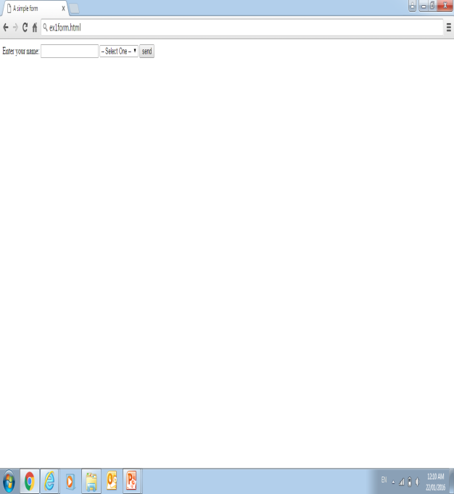

Accessing a web page hosted on a WAMPServer
Send HTML
output
Browser
WebServer
PHP script
Send
data
Request page
web browser
Request
data
Run Script
PHP
Engine

Slide 22

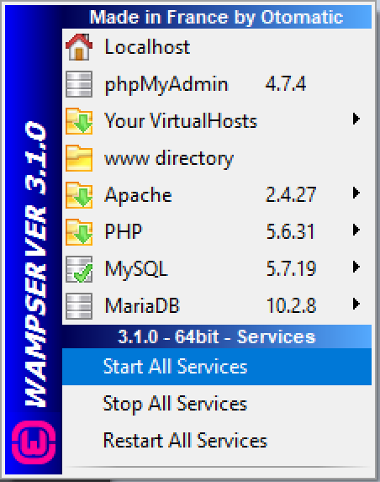
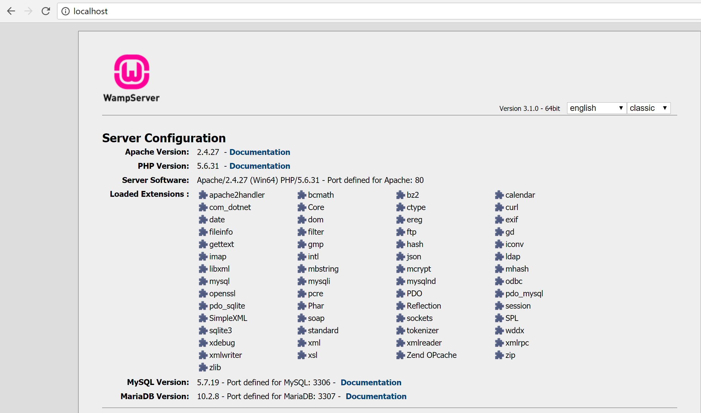
WampServer – Localhost
Web Server (Apache)
Accessing default home page on local web server
http://localhost is your domain name to access your website [IP Address of local machine is 127.0.0.1]

Slide 23
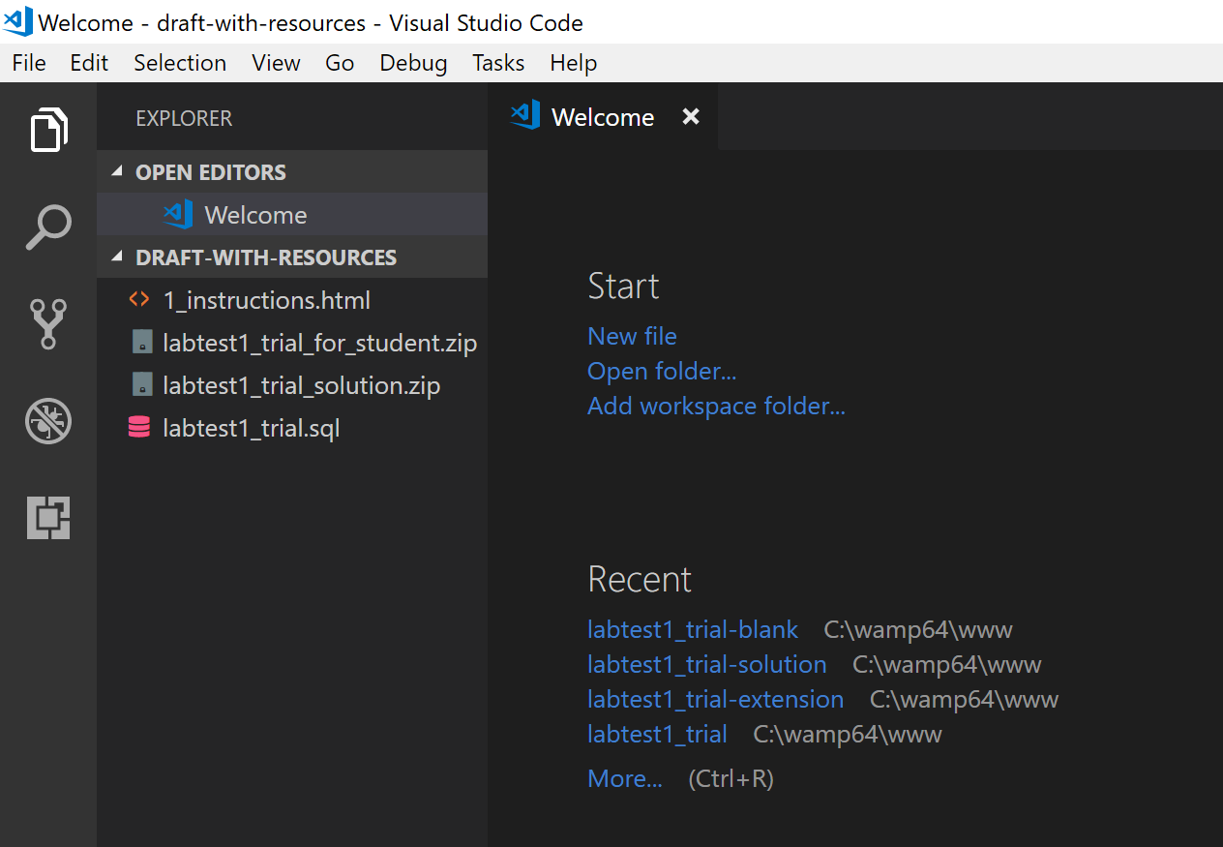

Visual Studio Code
PHP Editor, HTML Editor, many more …

Slide 24
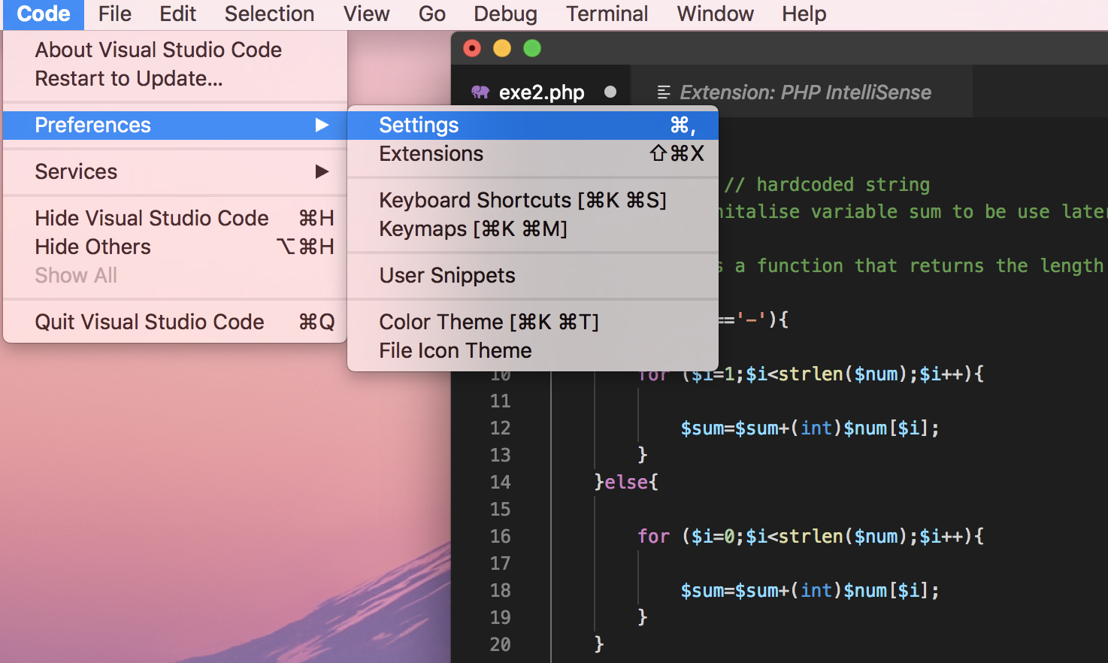
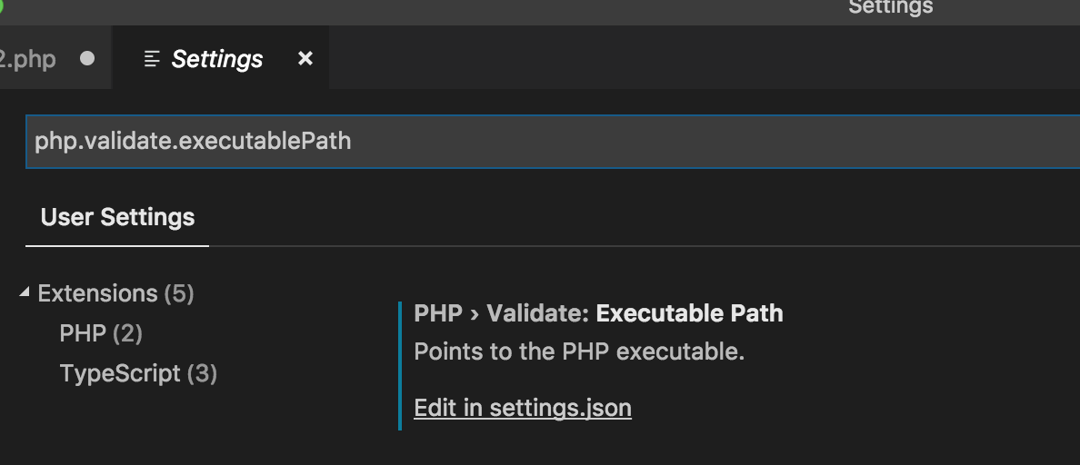
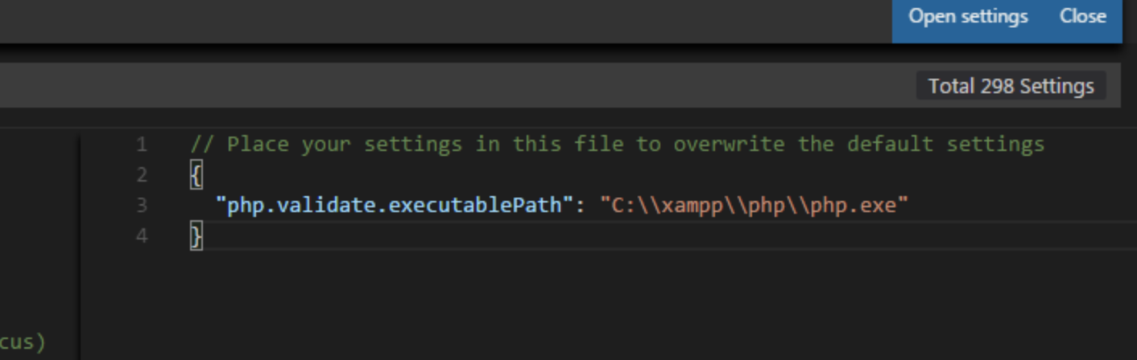
PHP intellisense extension
Install PHP intellisense extension for code completion suggestion
After installing, you may need to specify path to PHP 7
Goto Code\\Preferences\\Settings
Type php.validate.executablePath
Click settings.json file
Specify path to PHP 7 in user settings (e.g., c:\\wamp64\\php\\php.exe)
Notes:
It was necessary to do this in Mac machine
Not sure if it is the case for Windows

Slide 25
Exercise 1: Installing WampServer
Install WampServer following the installation guide
Installation guide is available for download from eLearn

Slide 26

Exercise 2: Hello World
Install Visual Studio Code and Chrome
Create a simple hello_world.html using Visual Studio Code
Deploy it in WampServer (www folder)
View it using Chrome

Slide 27

Key Concepts
Web concepts: URL, HTTP, DNS server, web server, resources, etc.
WAMPServer and its installation
Installation of other supporting tools
Writing and hosting your first webpage

